Slide 1

Unit 4
In this lesson, you will learn
Question type : Multiple choice question, T/ F/ NG
MCQ: main idea, inference, detail

Slide 2
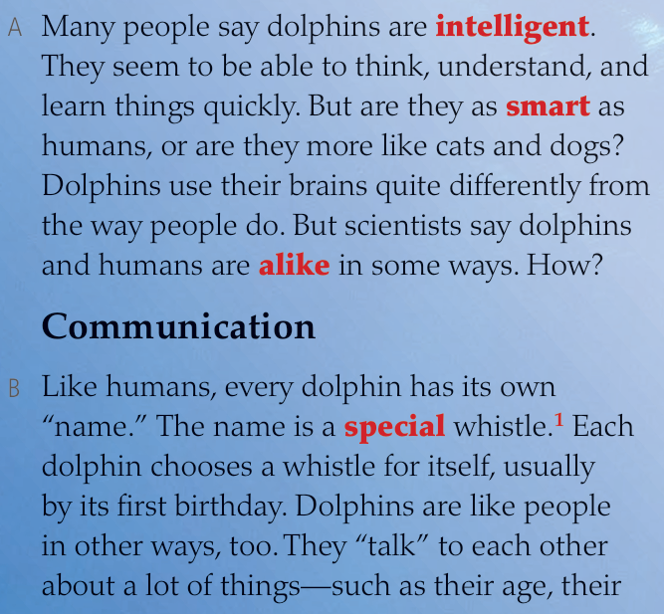
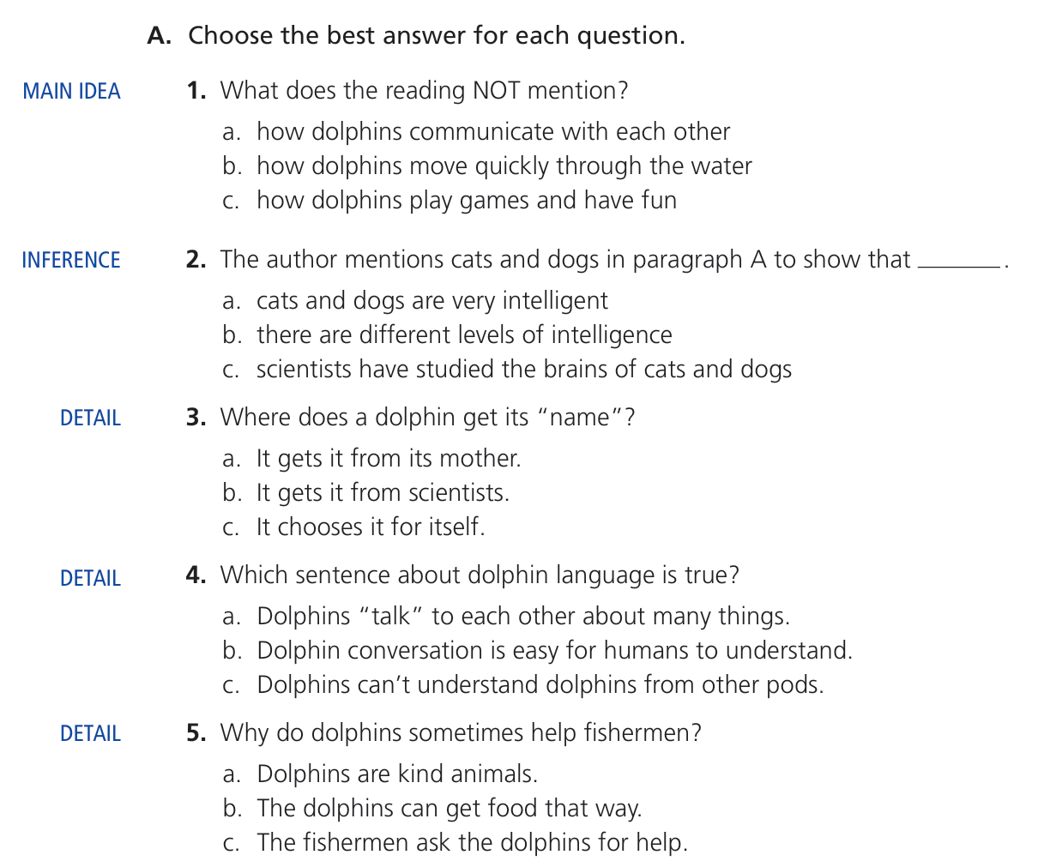
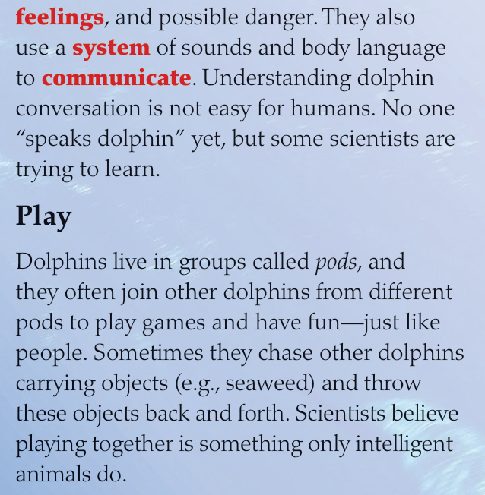
Question type 1 – multiple choice question

Slide 3
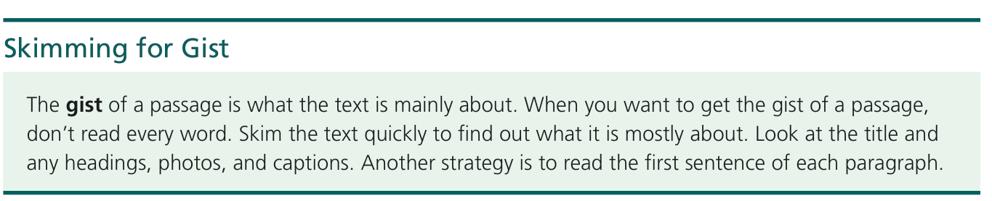
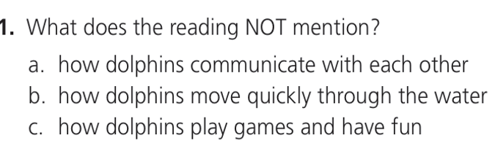

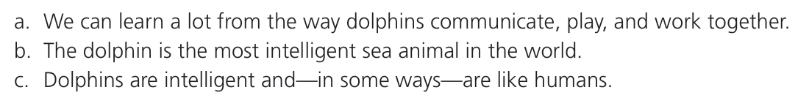
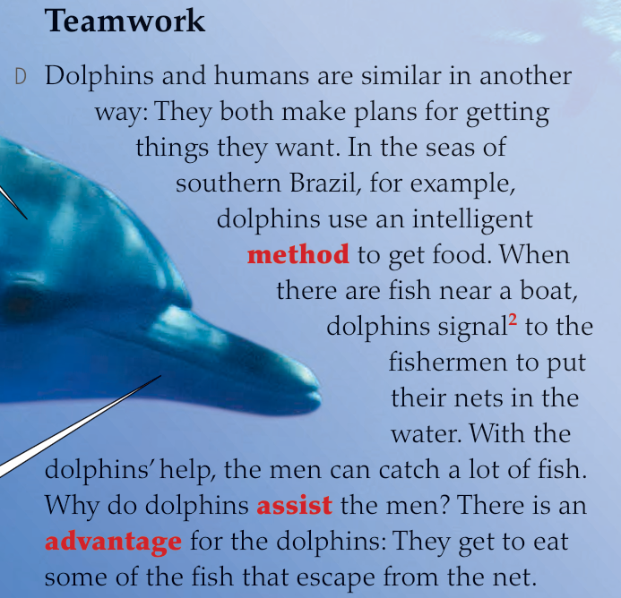




MCQ - Main idea question

Slide 4







Question type 1 – multiple choice question

Slide 5
Reading 1

Slide 6
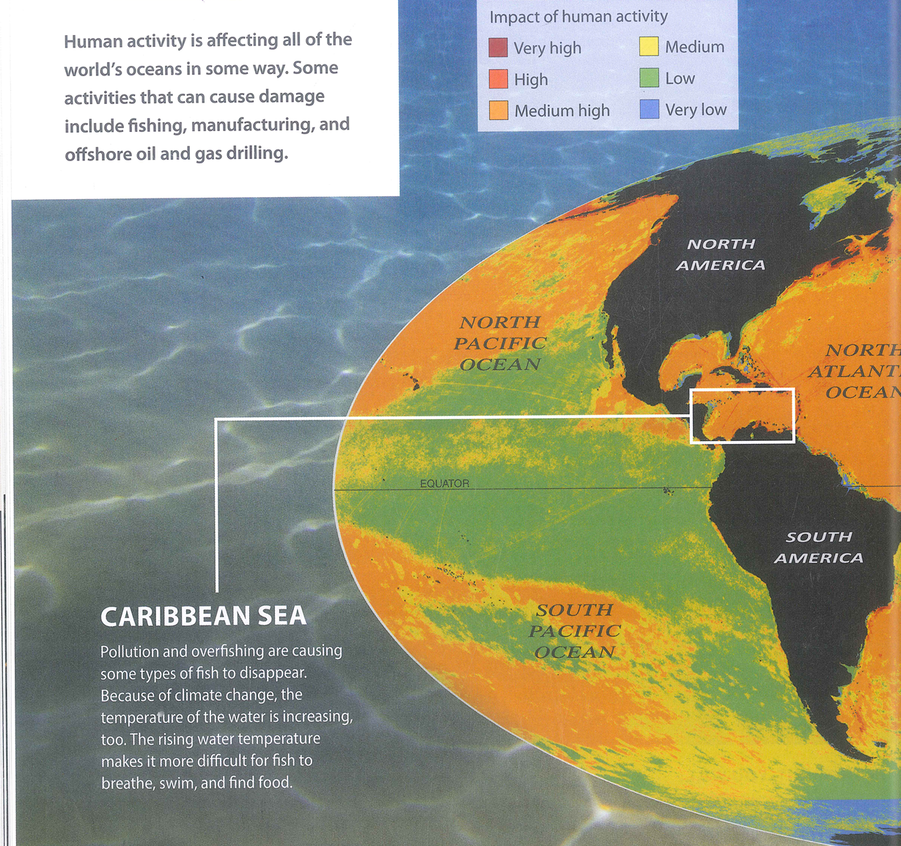
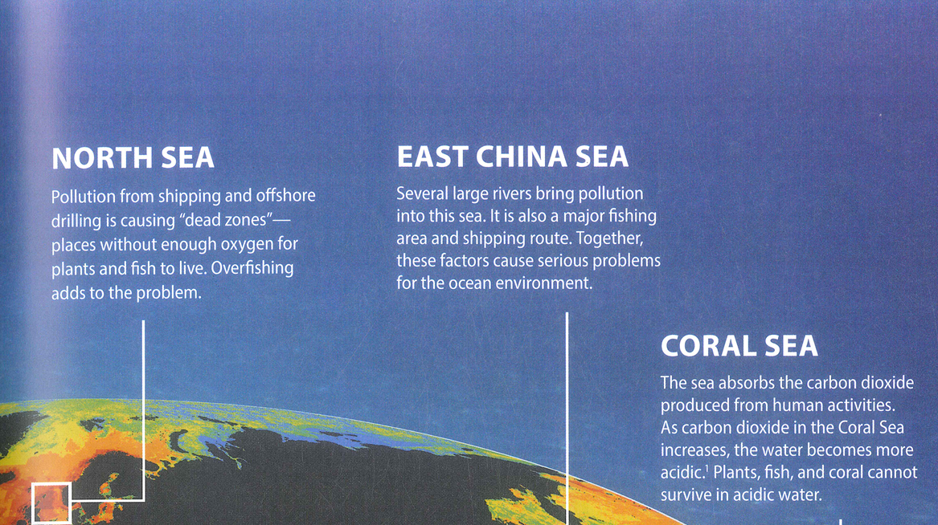
Offshore: connected to the production of oil and gas at a distance from the land or under the sea

Slide 7
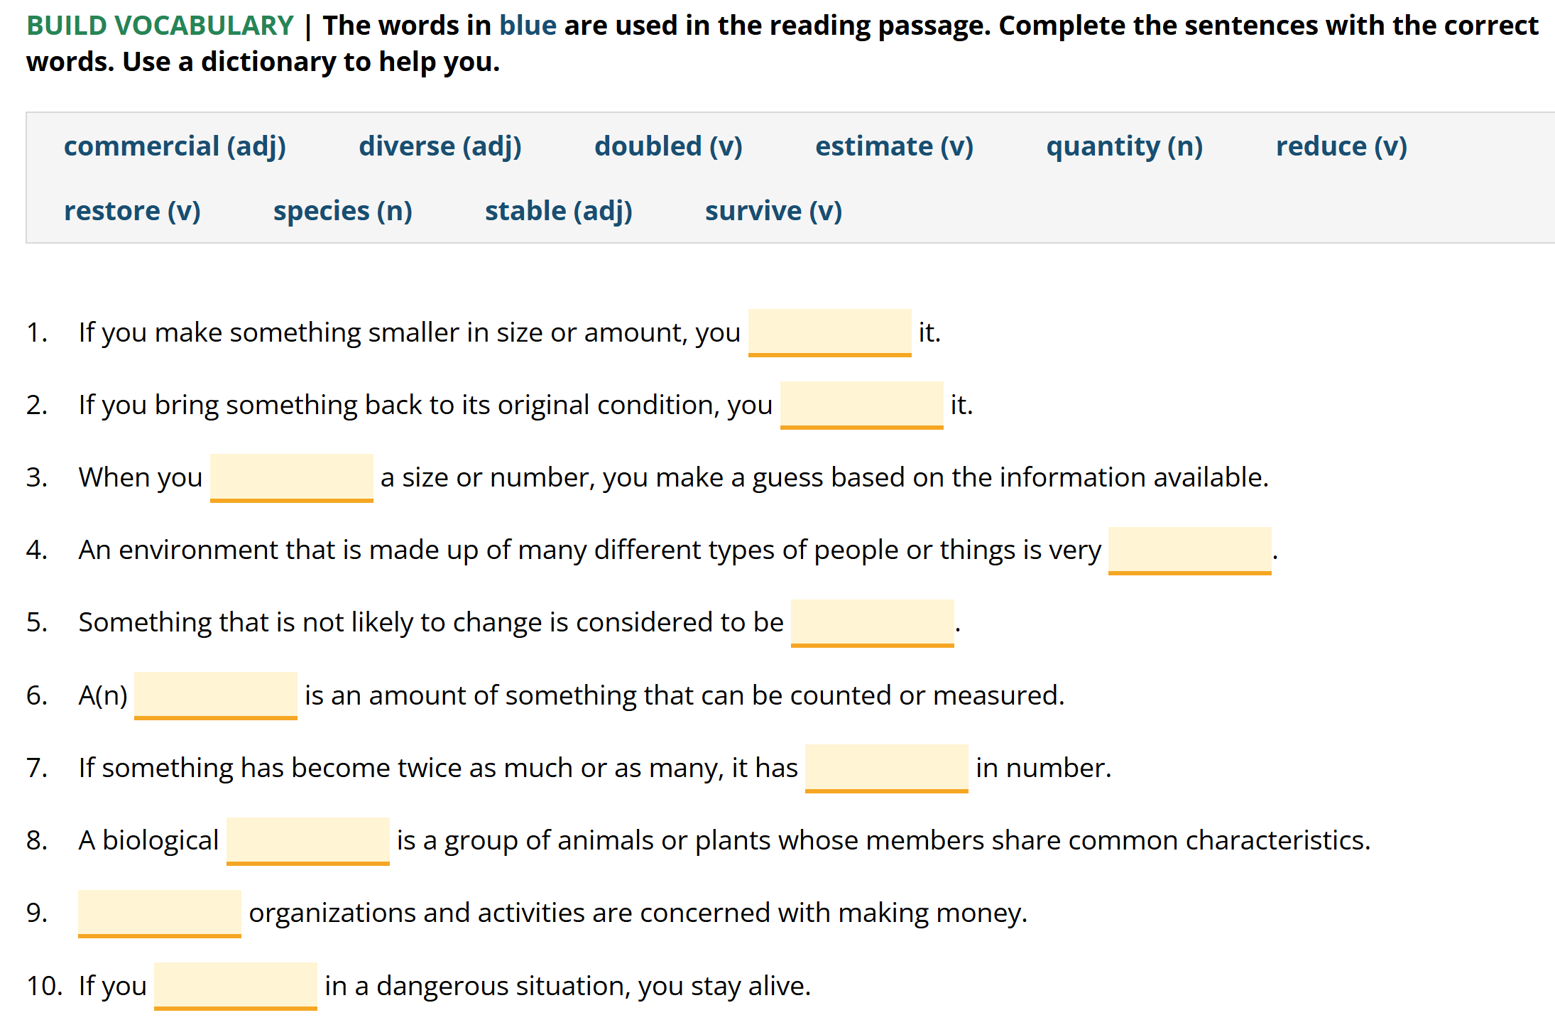
Language development
reduce
restore
estimate
diverse
stable
quantity
doubled
species
Commercial
survive

Slide 8
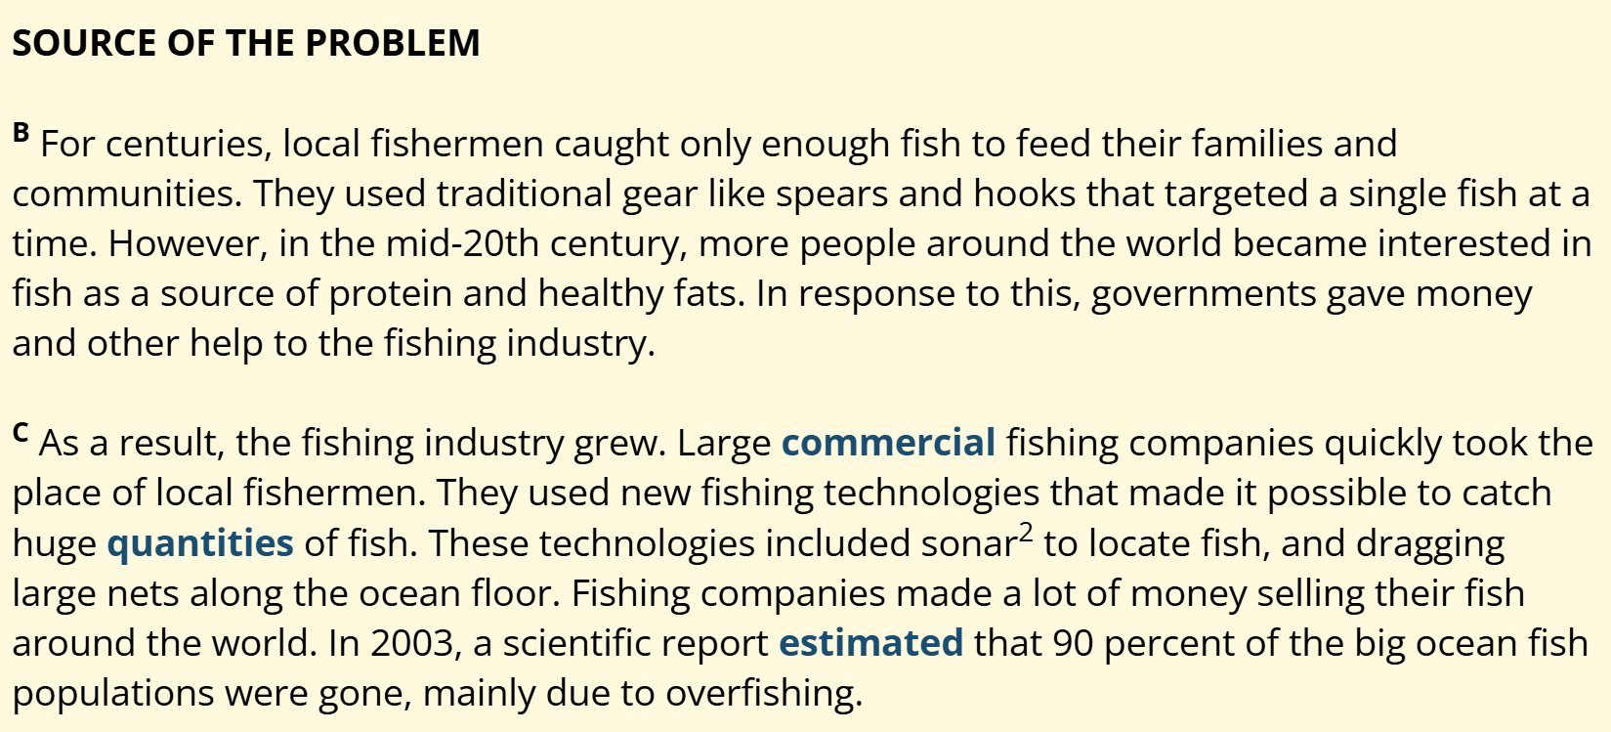
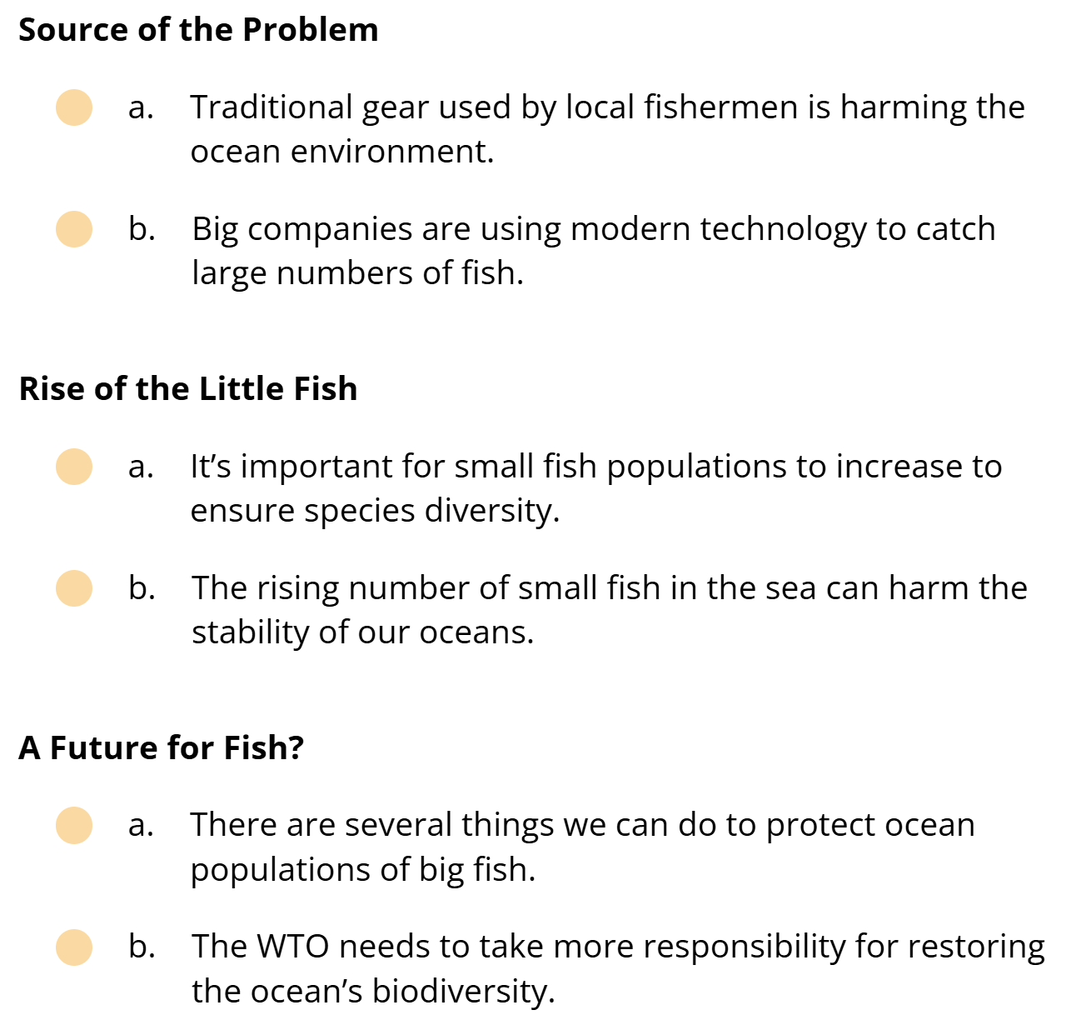
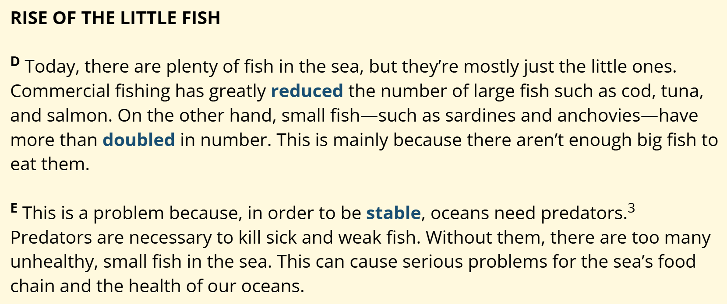
Reading comprehension – the main idea

Slide 9
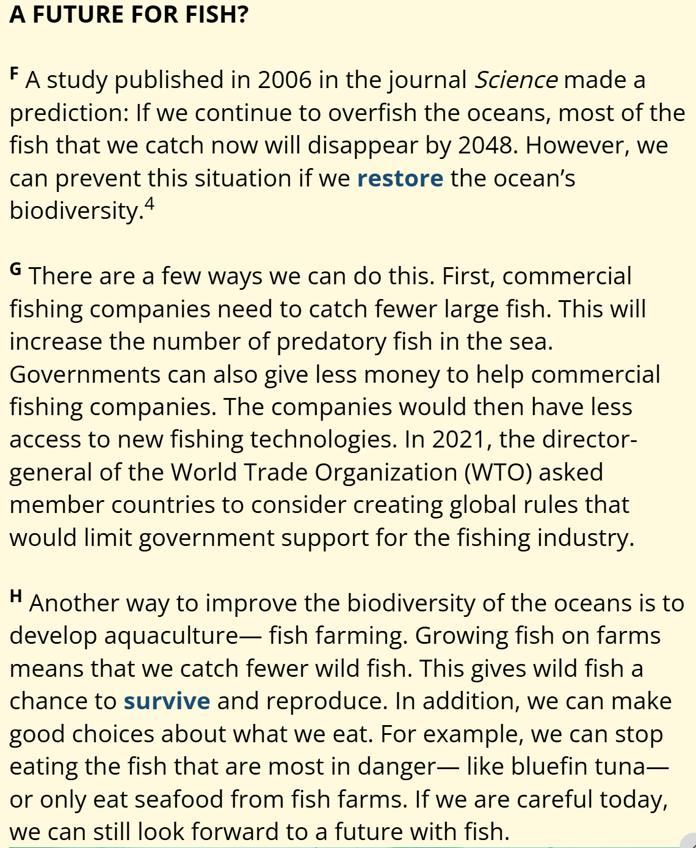




Reading comprehension – the main idea

Slide 10
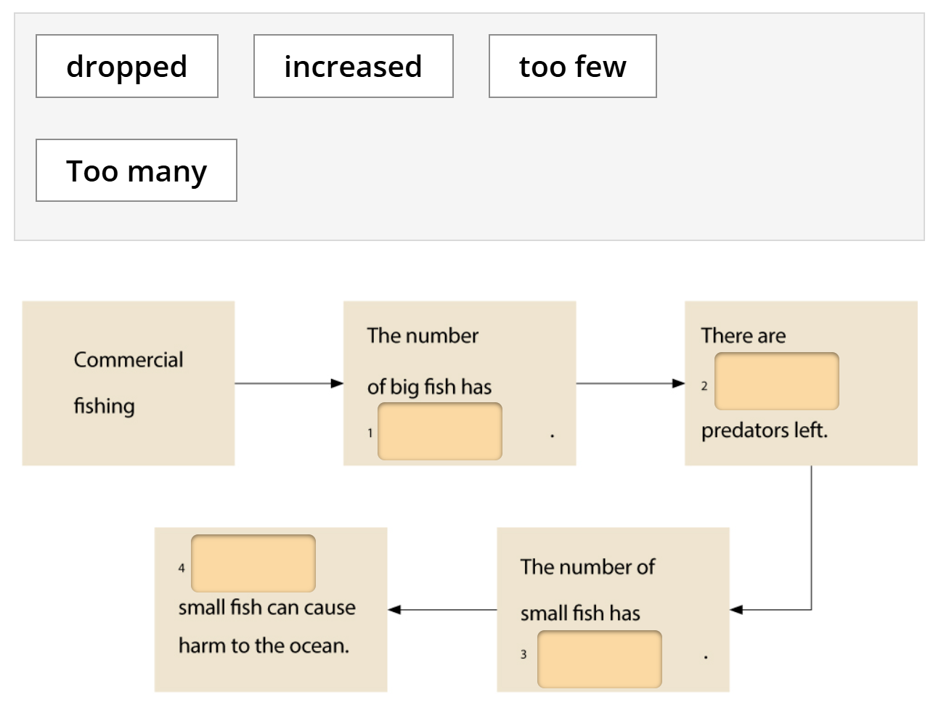
Reading comprehension – a process
Too few
dropped
Too many
increased

Slide 11
Reading 2

Slide 12
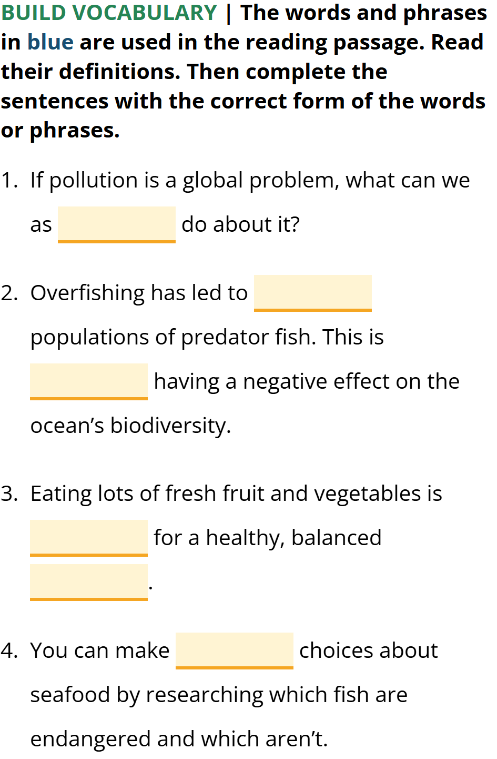
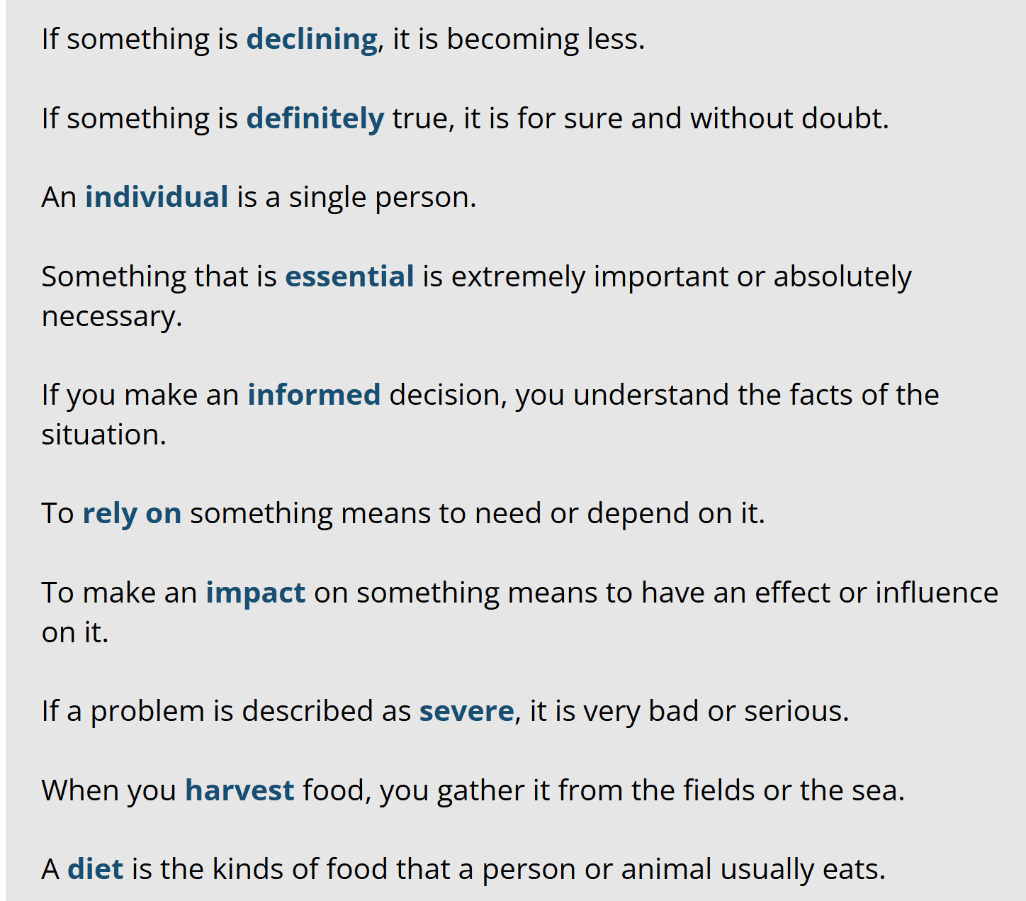
Language development
individuals
declining
definitely
essential
Informed choices = An act of choosing when having enough knowledge/ info
diet
informed

Slide 13
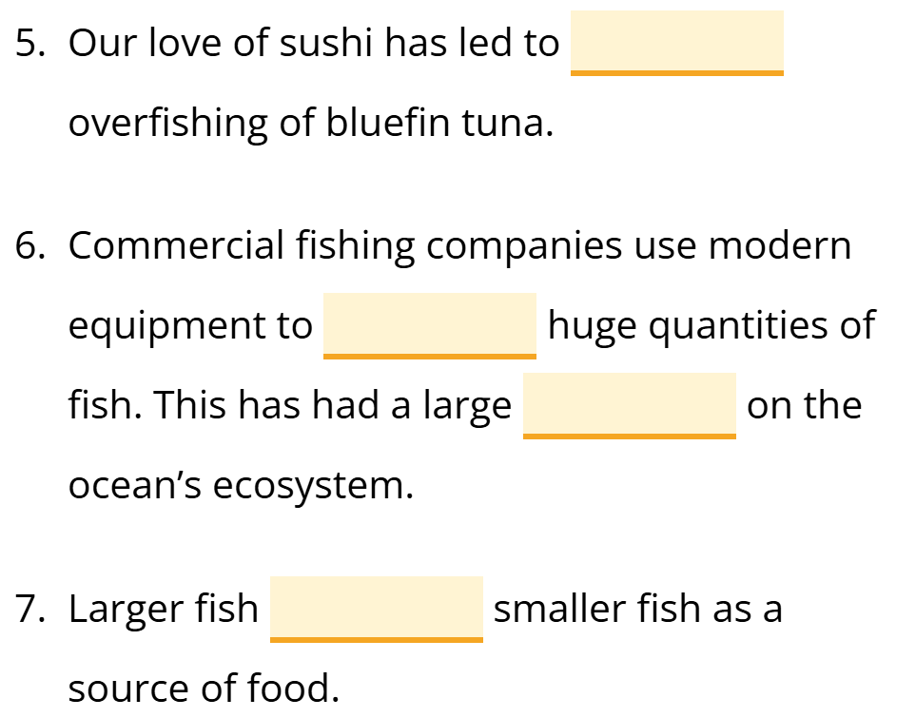
Language development
severe
harvest
impact
rely on

Slide 14
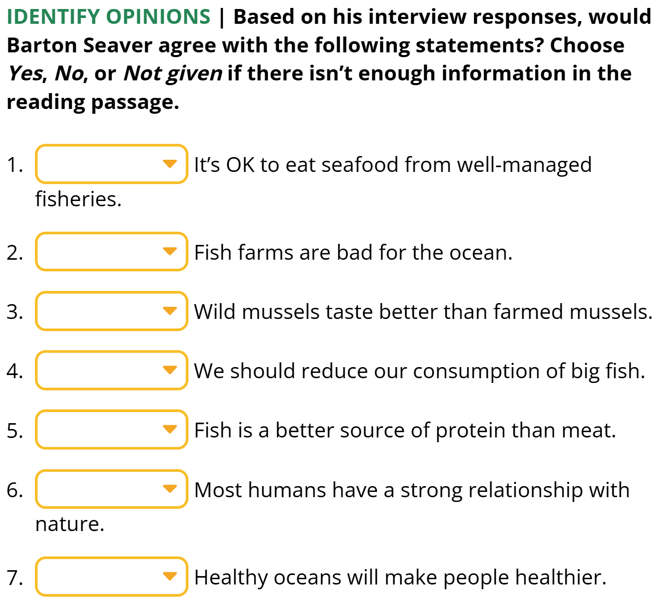
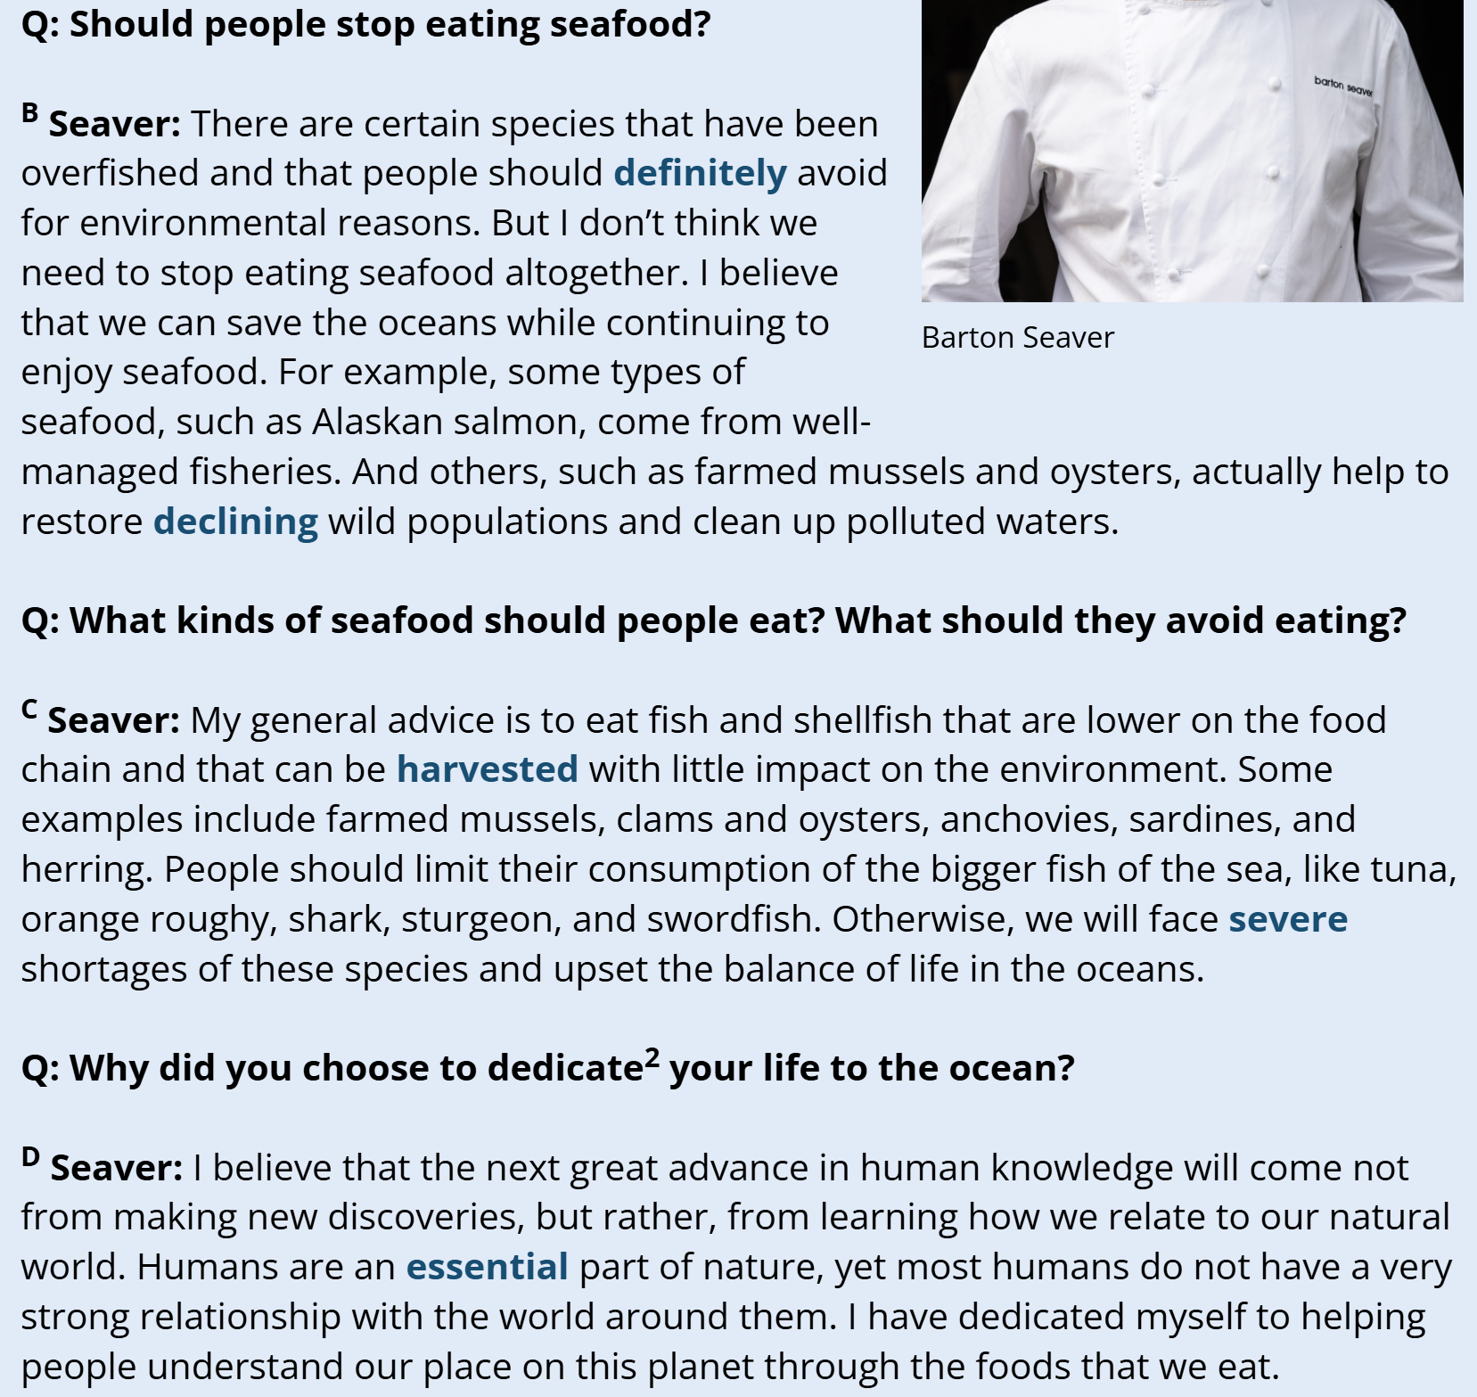





Reading 2 – details – T/F/NG
Y
N
NG
Y
NG
N

Slide 15
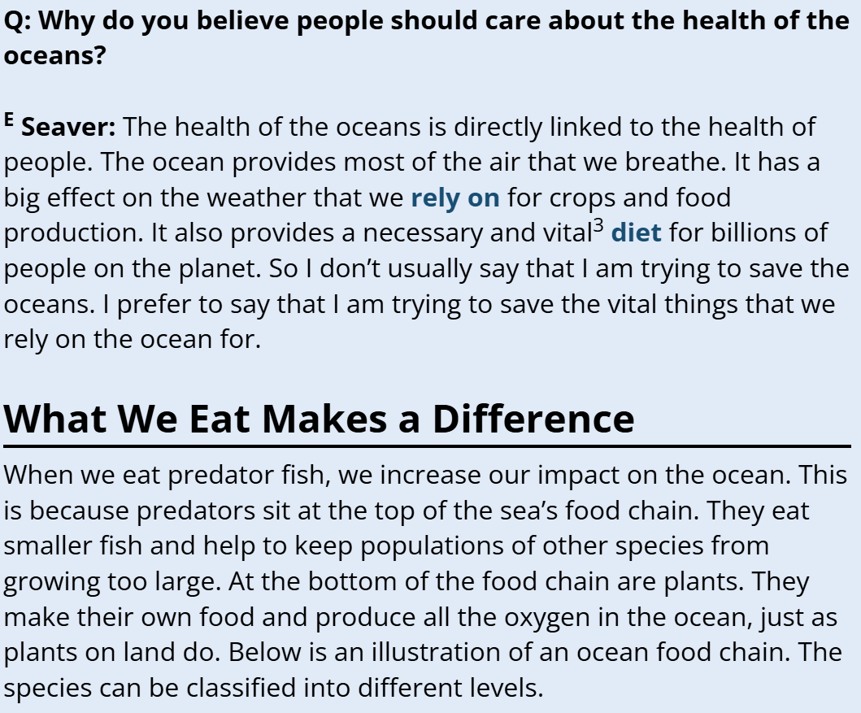
Y

Slide 16
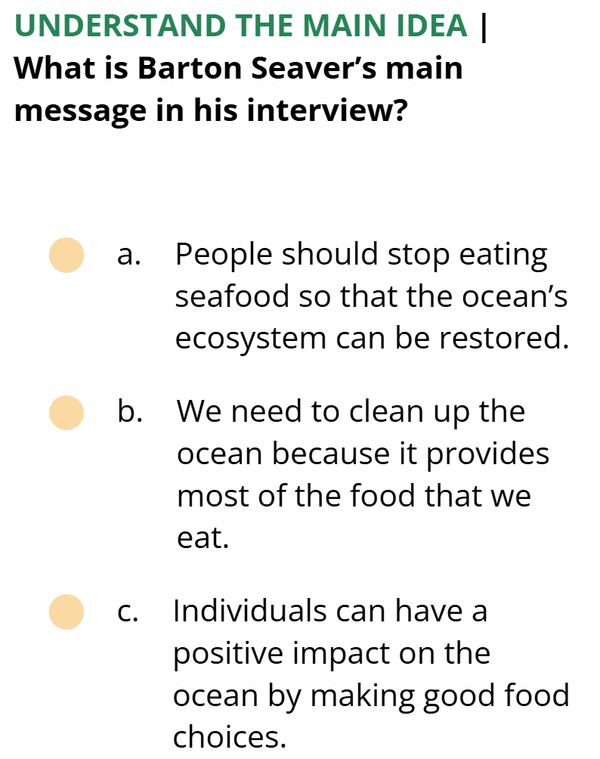
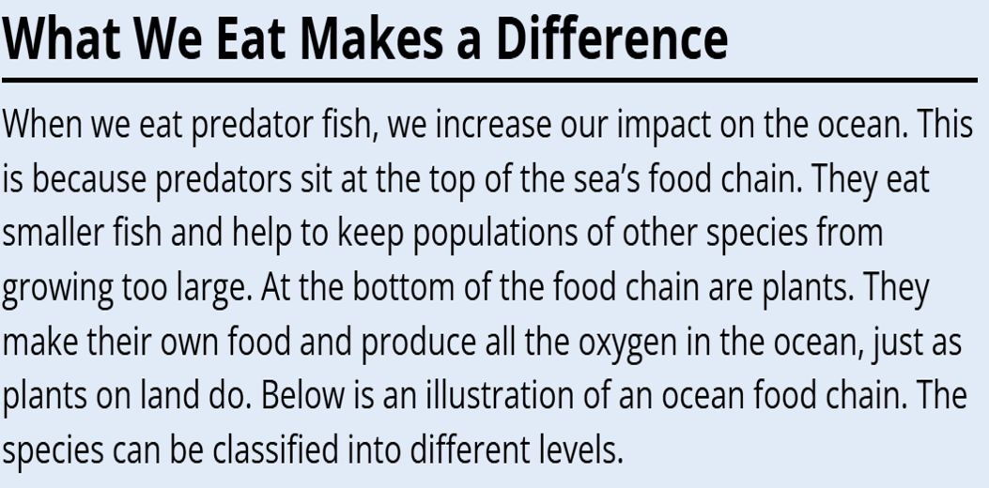

Reading 2 – the main idea

Slide 17
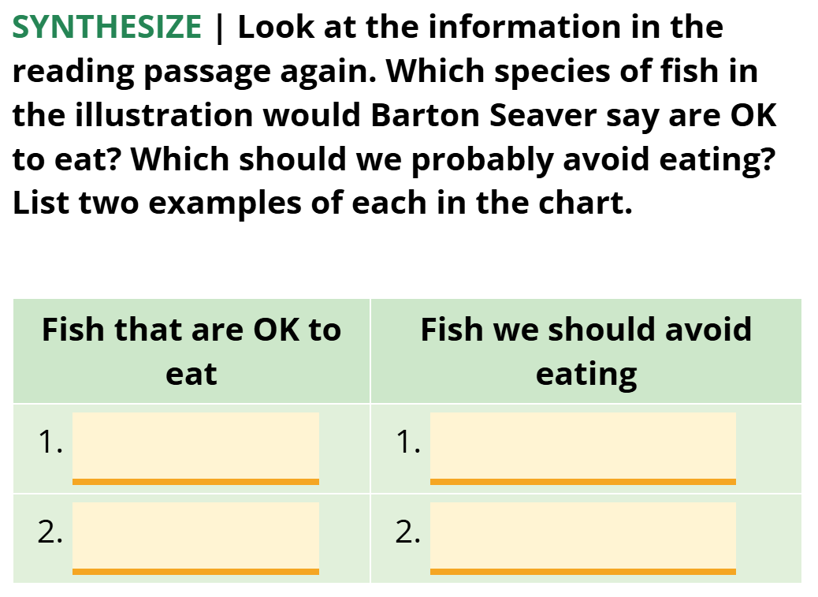
Reading 2 - details

